Slide 1


Hope to Skills
Lecture# 13
Irfan Malik, Dr. Sheraz Naseer

Slide 2
Agenda
Openai Image Generation using Dall-E
What is Hugging Face?
Pipelines
Sentiment Analysis
Name Entity Recognition
Text Summarization
Object Recognition

Slide 3
Previous lecture:
Lecture 12 - Introduction to API
Click Here

Slide 4
Image Generation using the Dall-E

Slide 5
Dall-E
DALL·E is an artificial intelligence model developed by OpenAI.
It is designed to generate highly creative and unique images from textual descriptions.
DALL·E has the ability to understand and follow detailed instructions for generating images.
https://openai.com/dall-e-2
https://openai.com/dall-e-3

Slide 6
Hugging Face
Hugging Face is an open-source library and platform for Natural Language Processing (NLP).
It provides a wide range of pre-trained models and tools that make it easier to work with NLP tasks.
Hugging Face is beginner-friendly and widely used by researchers and developers.

Slide 7
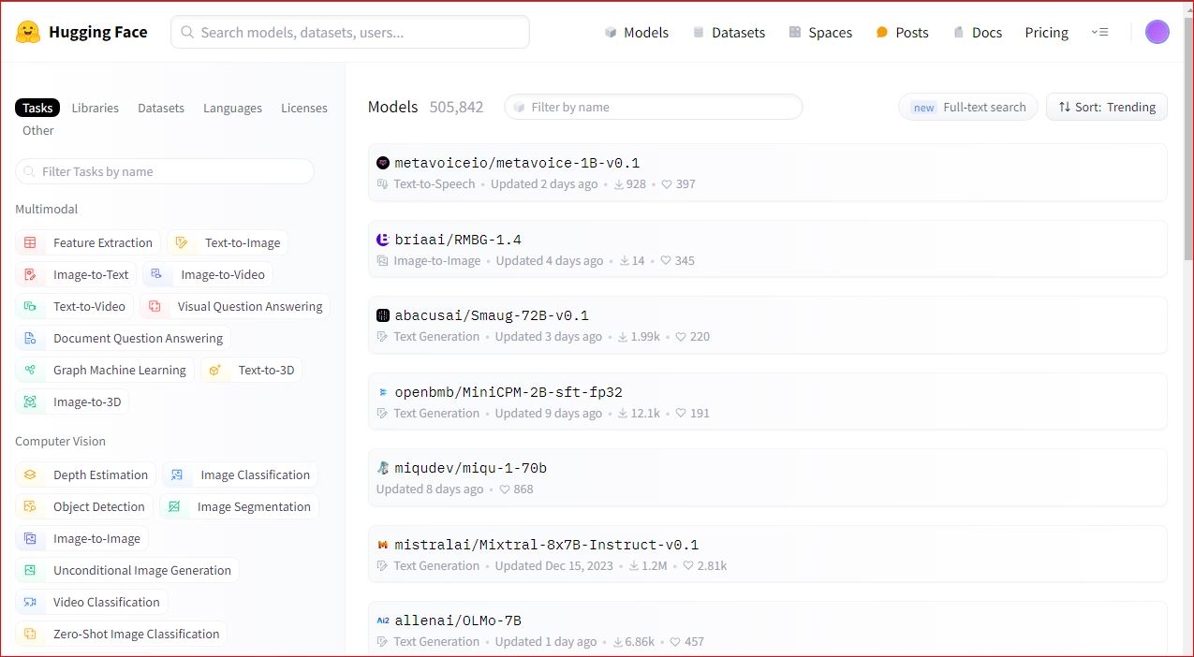

Slide 8
Hugging Face Pipeline
Hugging Face Pipelines are a high-level and user-friendly API provided by the Hugging Face library.
They enable developers and researchers to perform various Natural Language Processing (NLP) tasks with just a few lines of code.
Pipelines contains complex NLP models and processes, making it easy to use and integrate them into applications.
To Read more about Hugging Face click here

Slide 9
Hugging Face API:
Hugging Face offers a powerful API and platform for natural language processing (NLP) tasks. The Hugging Face API provides access to a wide range of pre-trained models for tasks such as text classification, sentiment analysis, question answering, and language generation.
https://huggingface.co/docs/api-inference/index

Slide 10
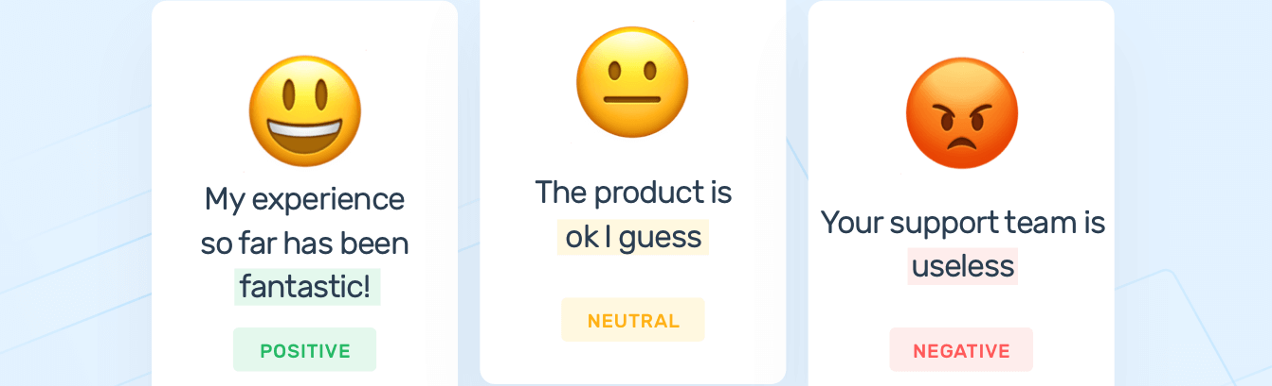
Sentiment analysis:
Sentiment analysis, also known as opinion mining, is a natural language processing (NLP) technique used to determine the sentiment or emotion expressed in a piece of text.

Slide 11
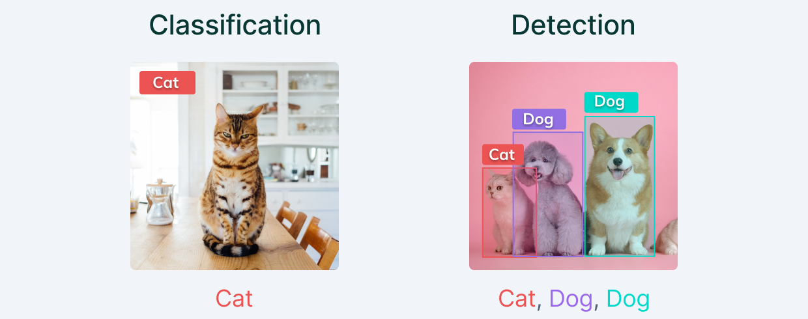
Object Recognition:
Object recognition, also known as object detection, is a computer vision task that involves identifying and locating objects within an image or video. The goal is to not only recognize the presence of objects but also to accurately localize and classify them.

Slide 12
Object Recognition:

Slide 13
Supported Tasks
Hugging Face Pipelines support a wide range of NLP tasks, including:
Text Classification
Sentiment Analysis
Named Entity Recognition (NER)
Text Summarization
Image Classification
To read more visit Hugging face

Slide 14
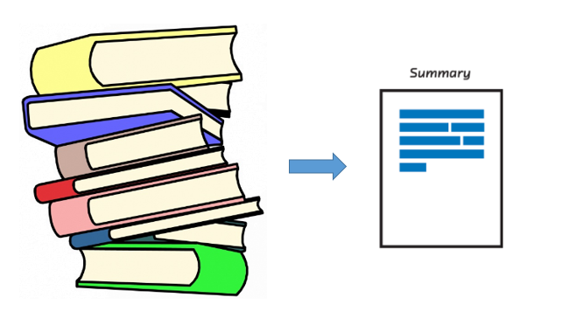
Text Summarization
Text Summarization is a technique used in Natural Language Processing (NLP) to generate a concise summary of a longer text while preserving its main points.

Slide 15
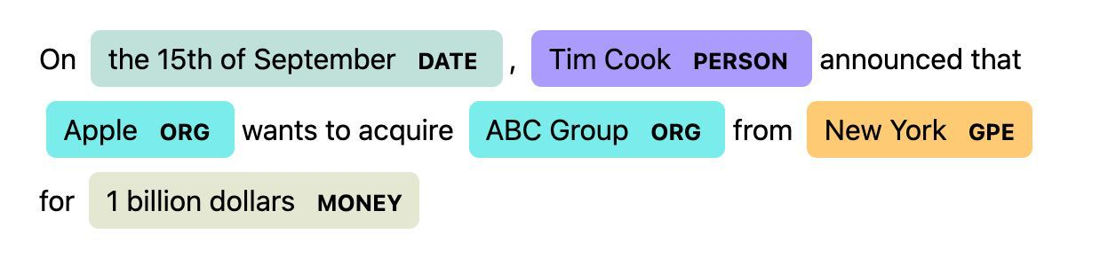
Name Entity Recognition (NER)
Named Entity Recognition (NER) is a subtask of Natural Language Processing (NLP) that focuses on identifying and classifying named entities in text.
Named entities are real-world objects such as persons, organizations, locations, dates, and more.

Slide 16
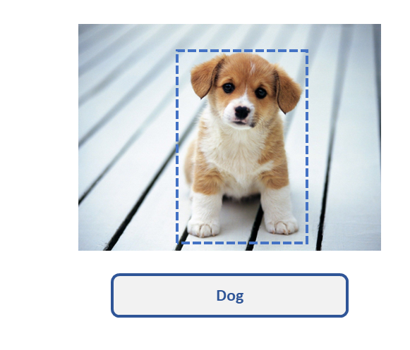
Image Classification

Slide 17
Google Colab Notebook

Slide 18
Summary
Image generation from Openai
Hugging Face library
Hugging Face pipelines

Slide 19
Quiz
Lecture 09 : Quiz 1
https://forms.gle/UcnDgXKUCyBcnTpU9
Lecture 10 : Quiz 2
https://forms.gle/aeyp3P9geBMMWnss8
Lecture 13: Quiz 03
https://shorturl.at/fktX8

Slide 20
Next Lecture:
Lecture 14 - Hugging Face 02
Click Here

